Slide 1
“Data” joBs in the US Market
Shilpa Muralidhar , Will Copeland, Han Yang

Slide 2
Why data science-related jobs ??
2.5 quintillion bytes of data is generated everyday.
Shortage of supply of Data Science workers.
This project will allow us to plan for our future.

Slide 3
Our Questions:
Where are the Data Jobs?
What are the Skillsets needed?
Which Industries are they in?
How well do they pay?

Slide 4
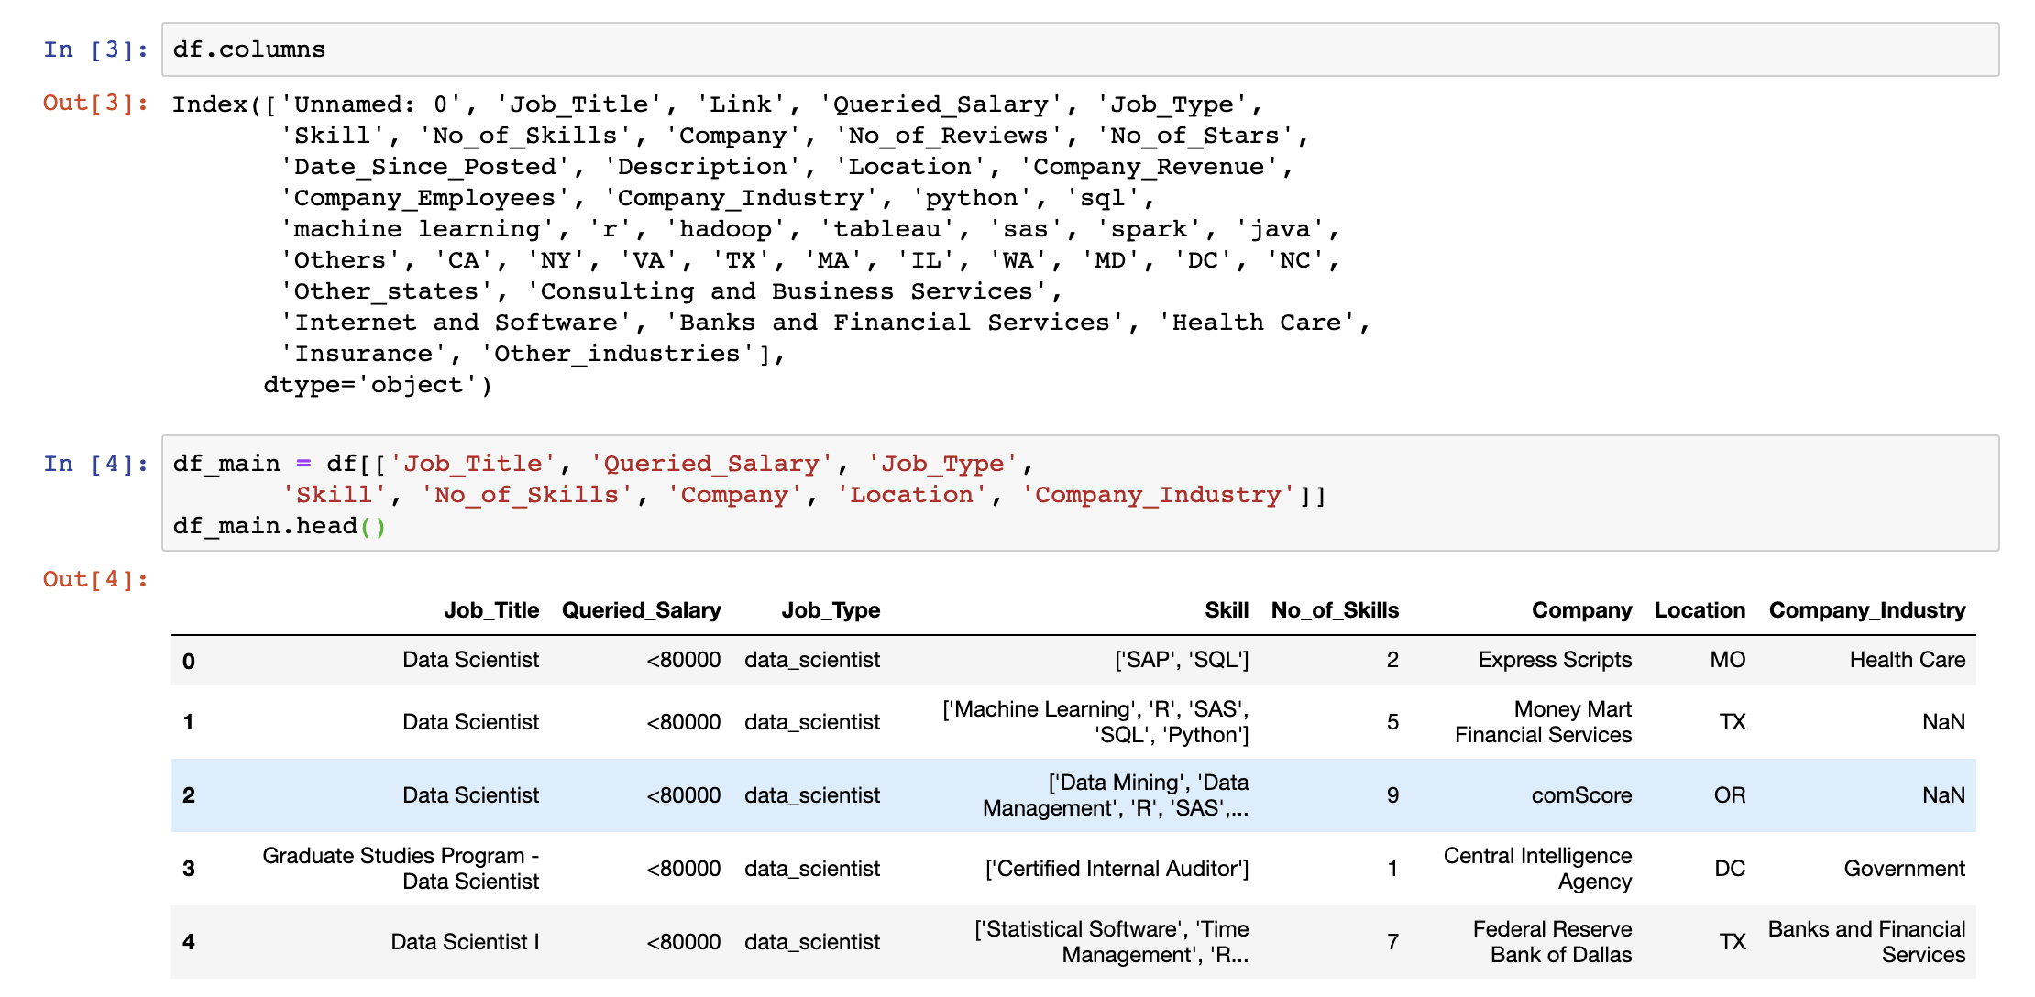
Data acquisition and cleaning:

Slide 5
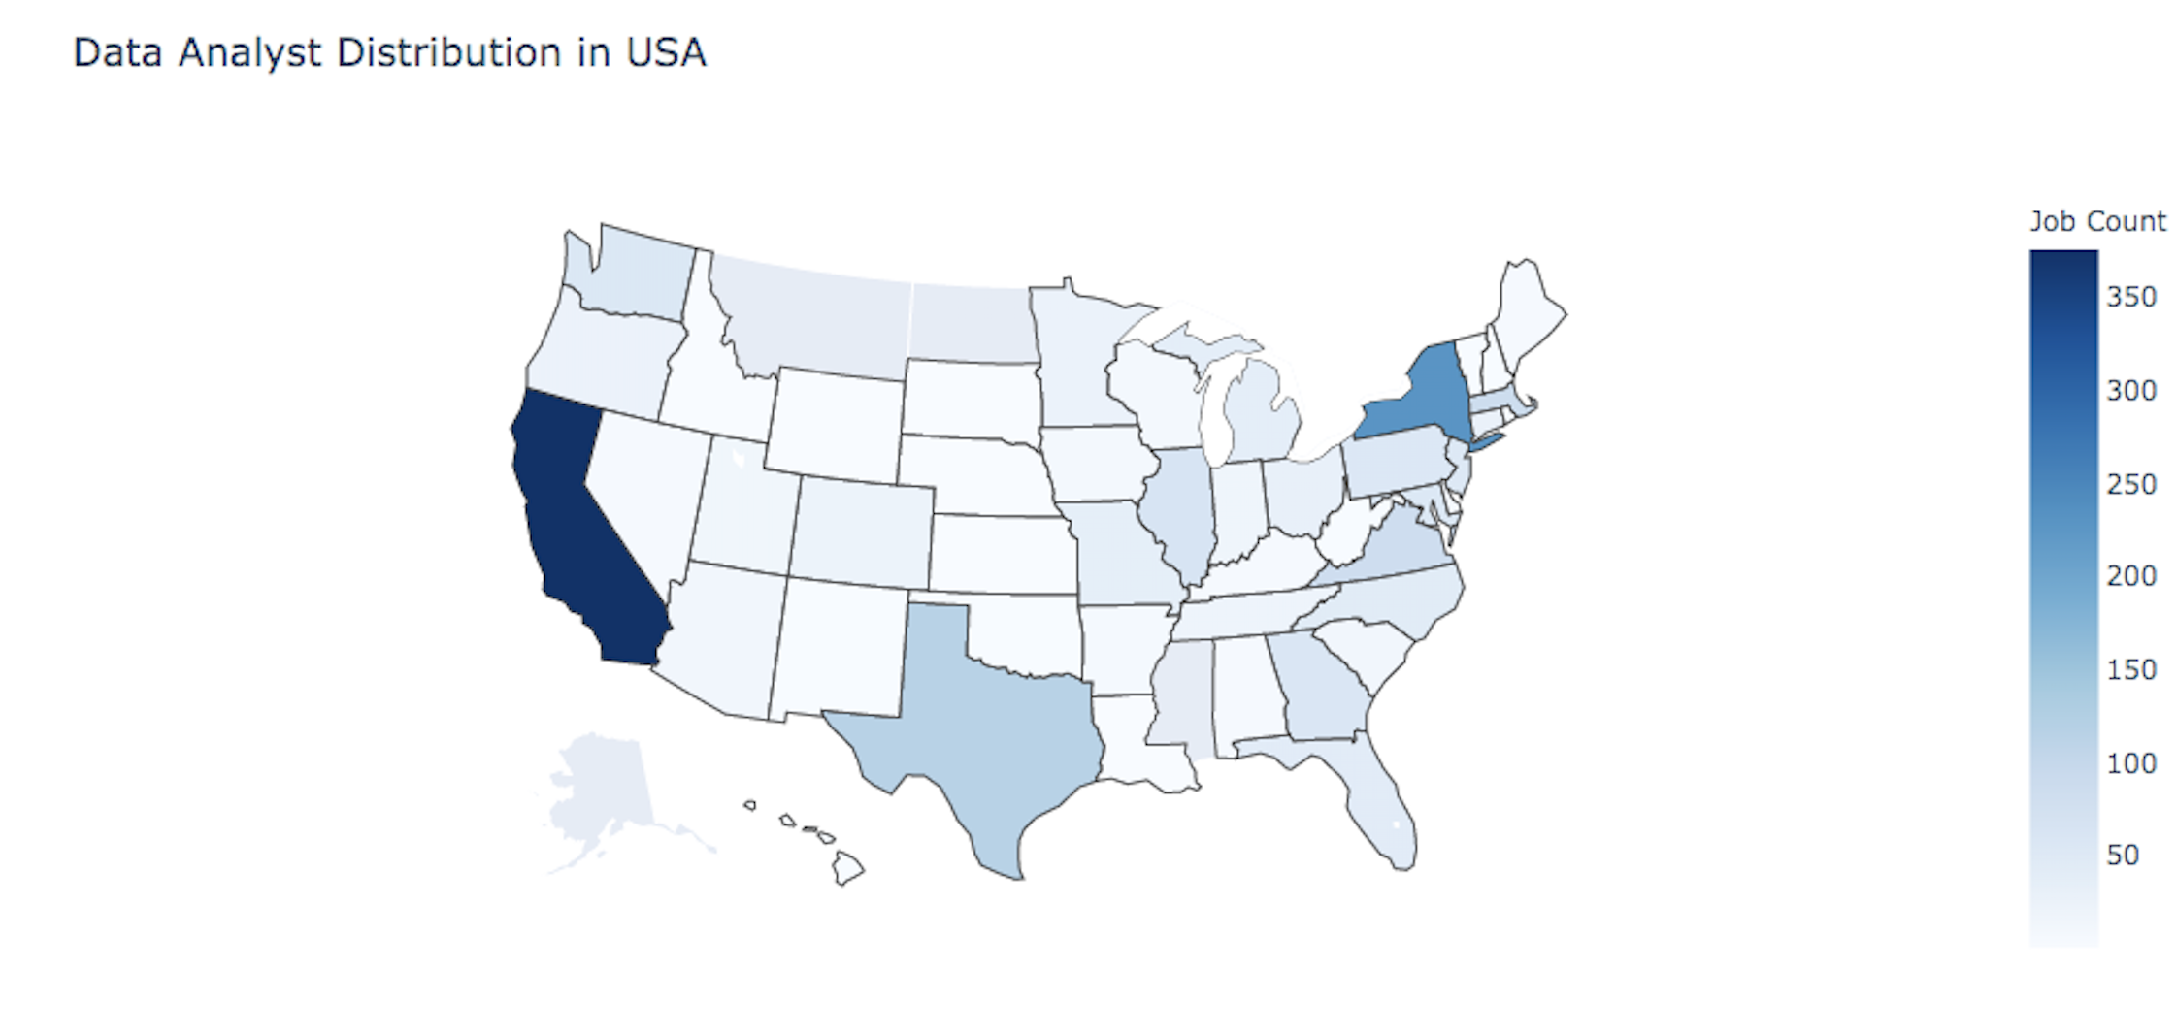
Availability of data analyst jobs in the u s a:

Slide 6
Comparison of Job Types based on Location:

Slide 7
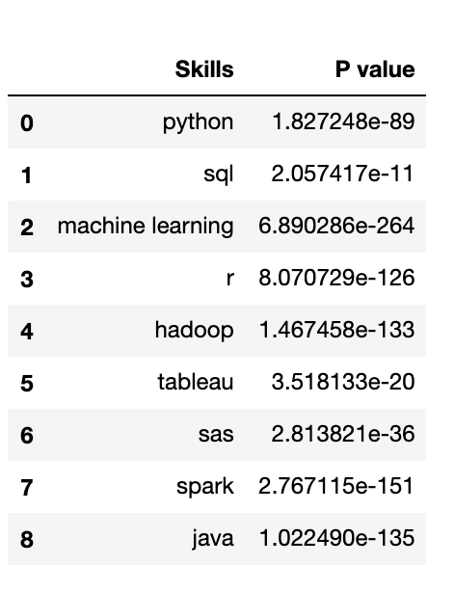
Job type v.s. skills
Job Type
Data Analyst, Data Engineer, Data Scientist
Skills of Interest
Programming Language: Python, Java
Data Base: SQL
Statistics: R, SAS, Machine Learning
Visualization: Tableau
Computing Framework: Hadoop, Spark
Data Cleaning
Python Pandas
Data Analysis
Chi-square Test

Slide 8
Cont’d
Job Type | Skills
Data Analyst | python | SQL | R | Tableau
Data Engineer | python | SQL | Hadoop | Spark | Java
Data Scientist | python | SQL | R | Machine Learning

Slide 9
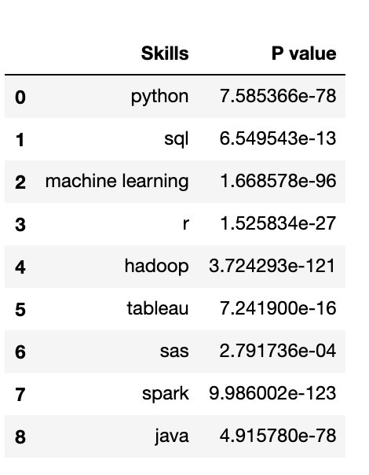
Salary v.s. skills
Salary Category
<80000, 80000-99999,
100000-119999, 120000-139999, 140000-159999
>1600000
Skills of Interest
Programming Language: Python, Java
Data Base: SQL
Statistics: R, SAS, Machine Learning
Visualization: Tableau
Computing Framework: Hadoop, Spark
Data Cleaning
Python Pandas
Data Analysis
Chi-square Test

Slide 10
CONT’D
Skills Worth Investing: Python, Spark, Java, Hadoop, Machine Learning
Essential Skills: SQL, R, Tableau, SAS

Slide 11
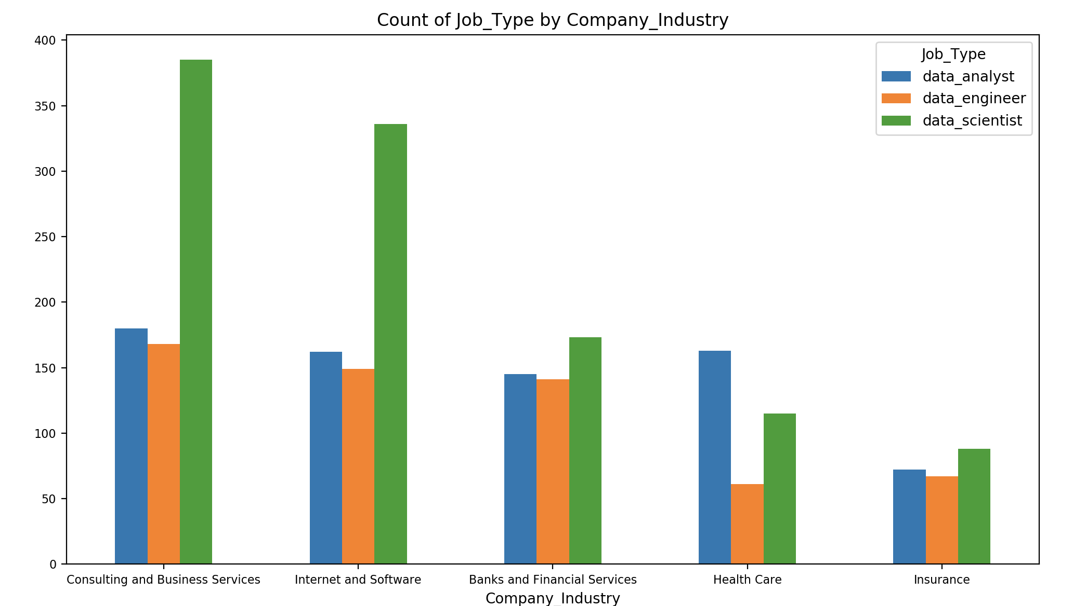
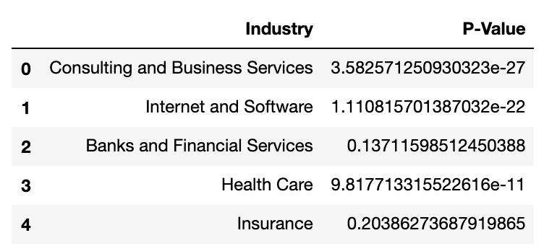
Which Industries have the most jobs?
Conclusion:
In the Banking and Insurance Industries the demand for data related jobs is not significantly different for different Job Types

Slide 12
Which Industries have the most jobs?
Conclusion:
In the Banking and Insurance Industries the demand for data related jobs is not significantly different for different Job Types

Slide 13
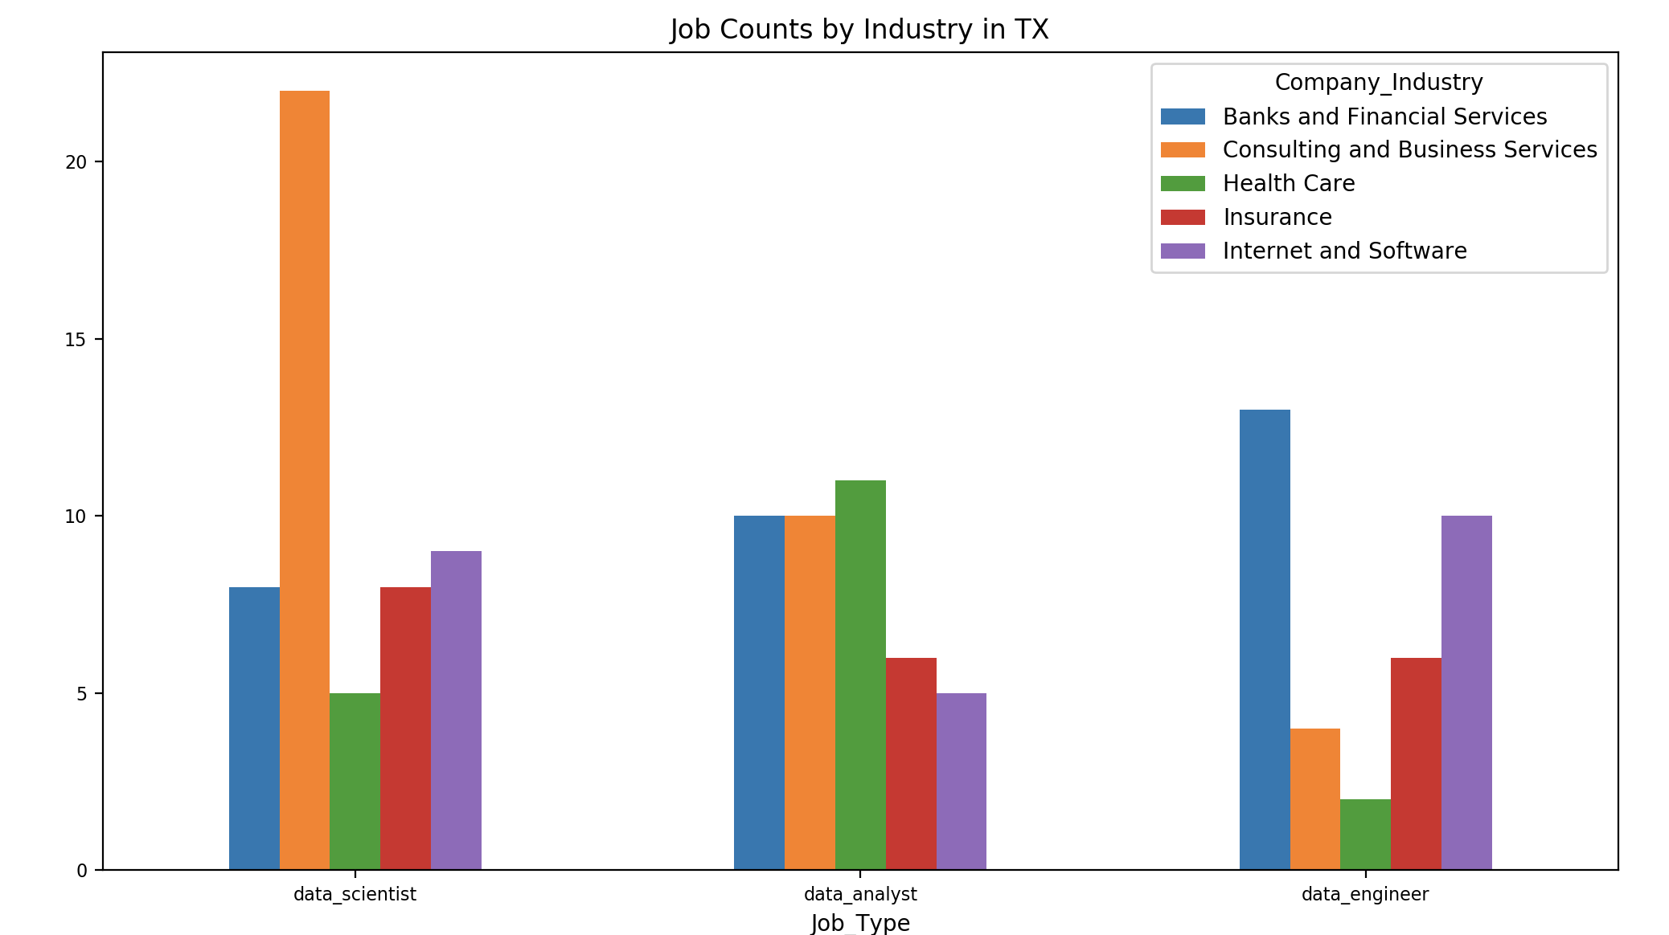
What Industries have the most jobs in Texas?
Higher Demand for Data Scientists in Consulting and Business Services
Higher Demand for Data Engineers in Banking and Financial Services

Slide 14
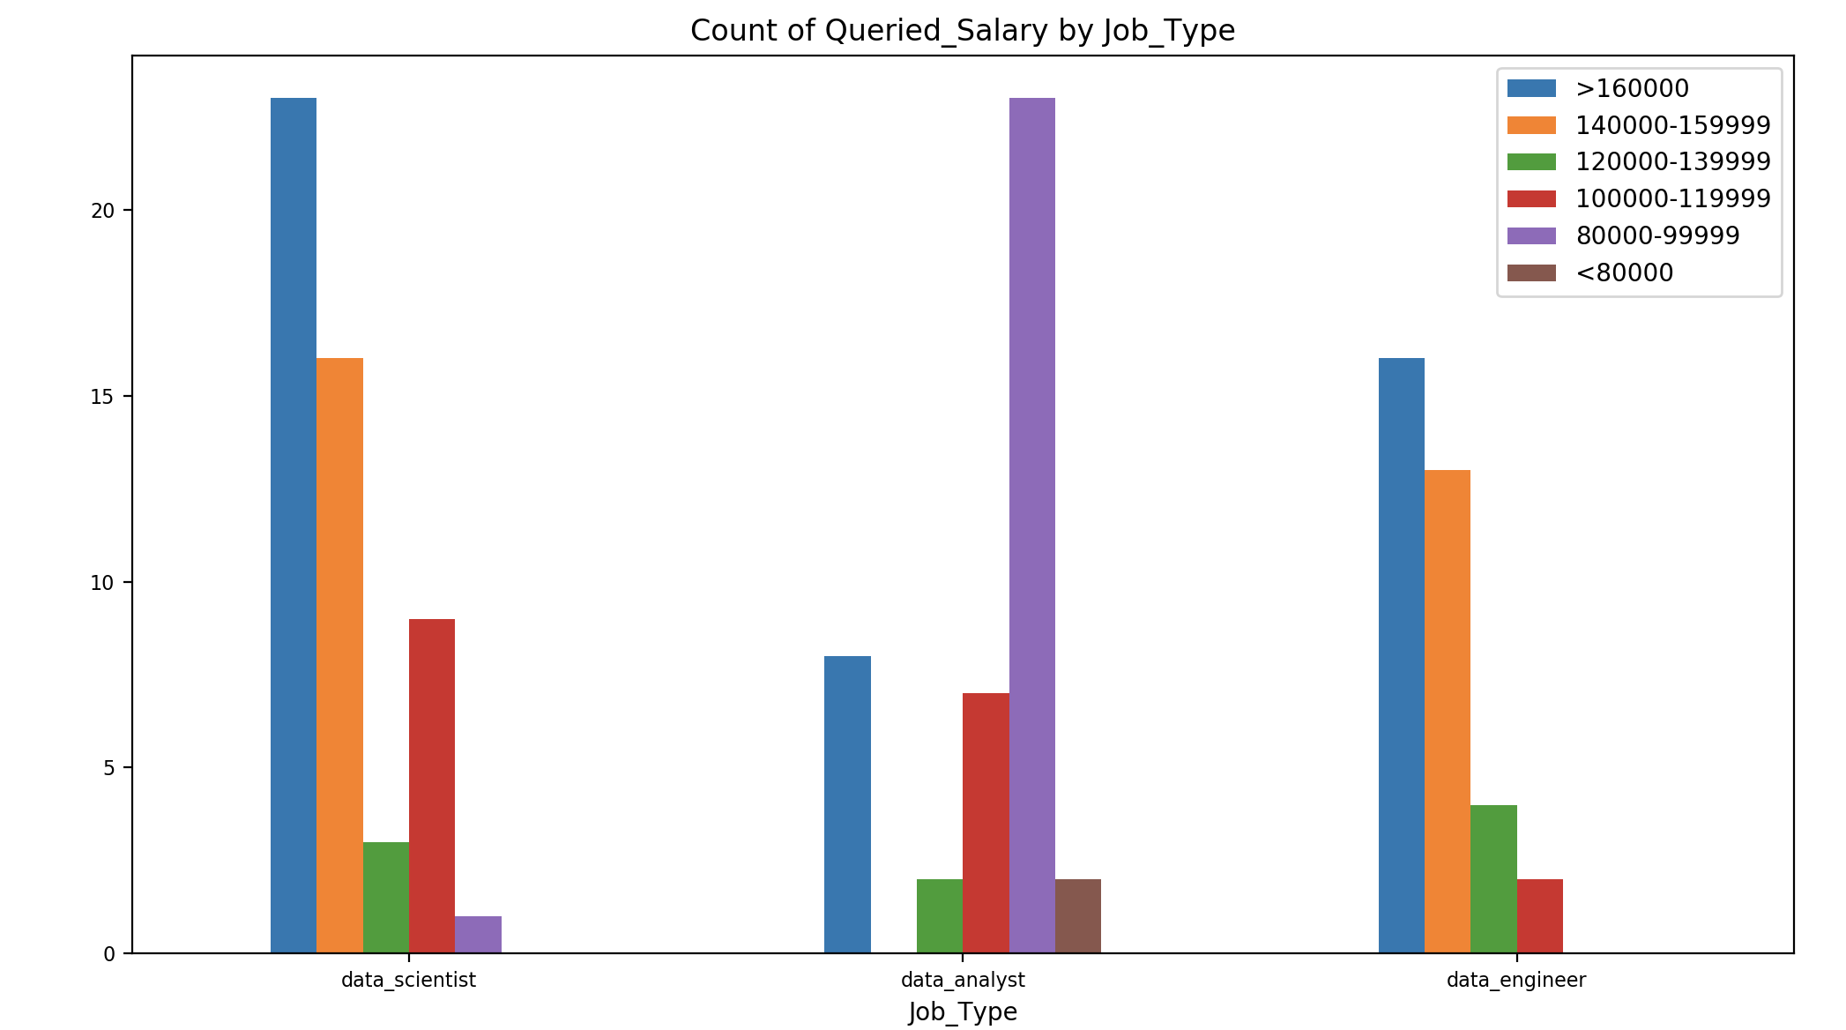
How Do jobs pay for data Analysts?

Slide 15
Thank you!
Questions?

Slide 16
